Slide 1
The Divah Filez
Advertising and Sponsorship Packet

Slide 2
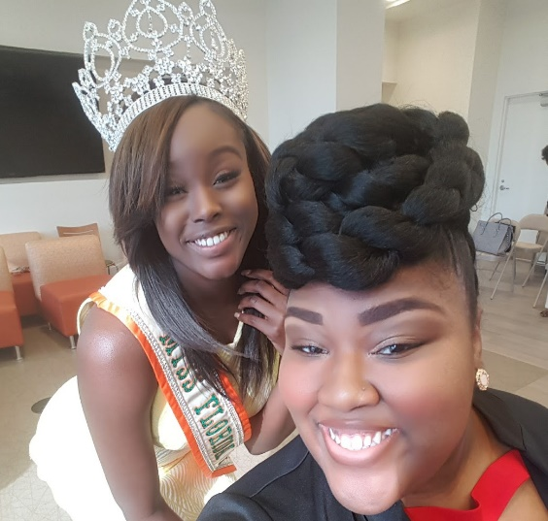
Table of Contents
As graduates of this proud UNIVERSITY, as young people like those who always stoked the fires of progress, our country is counting on all of you to step forward and help us with the work that remains. We need you.
- First Lady Michele Obama, North Carolina Agriculture & Technical State University
About the Divah Filez
About the Founder/Creator
HBCU and You
What’s New 2021-2022
Last Years Numbers and Demographics
Past Events
Divah Beat Suitez (Glam Suites)
Baggage Claim (HBCU Tour)
#IssaHBCUDay
Pre-Black Friday Shop & Model Call
8th Year Anniversary Celebration
Divah’s Doing it Big!
Radio and Indie Artists
Radio Advertising Space and Pricing
The Owner of the Divah Filez and Miss FAMU 2016-2017
Swear your oath not with your hand over your heart, but your hand outstretched to give, to serve, to do.
- Mayor Cory Booker, Hampton University

Slide 3
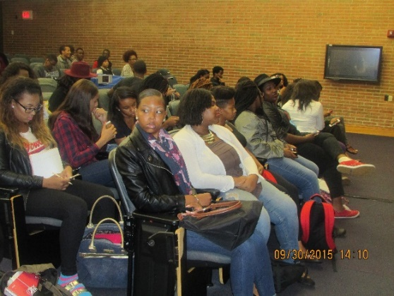
About the Divah Filez
The Divah Filez was created to provide HBCU Students with an opportunity to create, manage and run an online magazine / mobile application based on the topics an concerns that the HBCU and African-American Community will gravitate to, support and love.
The Divah Filez was created in the January 27,2014 during Spring Semester of 2014. We launched our website www.thedivahfilez.com
The Divah Filez touches on topics such as :
Politics- providing important up to the minute updates on important news and politics
Music- giving you one on one interviews, exposure to Indie Artists and the newest Hot Trax of today in every genre.
Fashion- covering the hottest looks from the runway to the red carpet of your favorite celebs and everyday people trending.
Entertainment and Celeb News- Dishing the gossip on celebs and those making a splash in the industry which one on one interviews and HBCU campus news.
Sports- covering sports news and scores from HBCU’s and Major Sports
Beauty and Wellness- Focusing on the mind body and spirit
The students have learned the basic workforce principles:
Responsibility
Accountability
Work Ethics
Teamwork
Branding and Business codes of conduct and practices
The students represent the academic majors of:
Business Administration
Mass Communications
Graphic Design
Get on File with The Divah Filez at Howard University

Slide 4
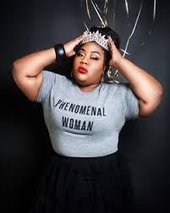
Founder/Creator Jazmyne Courtnii Byrd
Jazmyne Courtnii Byrd was born and raised in Cincinnati, Ohio. She attended Woodward High School where she graduated in 2004. She went on to further her education at Central State University wee she graduated in 2009 with a Bachelors of Arts in Psychology and Communications. She relocated to the Washington, DC area in 2009 post graduation where she currently resides. She is a contributing writer for several Magazines including Sister2Sister, The Hype Magazine, Kingdom Voices, Boss-EMag, Exude, Beautifully Said and Queen Size Magazine in the fields of Entertainment Fashion.
And in 2012 a major turning point in her life came in addition to writing she joined the team of Curves Rock Weekend who put on the first “Plus Size Fashion Show” in the DMV area where she served as the Marketing Coordinator. She starred in CRW “Vagina Monologues” in February 2012. Also in 2012 she became the Associate Editor of Ice Media Network were she managed the contributing writing staff and works closely with the creative team to acquire talent for the magazine.
A strong believer in giving back she has volunteered with Capital Cause literacy campaign and Study Sparks as a volunteer Tudor. An occasional Model she uses her Plus Size Figure to encourage and uplift Plus Size women everywhere by. She is an Active Member of NCNW of Prince Georges County. She joined the “Ntuned Show” radio show on BlogTalkRadio as the “Entertainment and Sports Guru”. She has two of her own segments entitled “Divah’s got the J” and “The Locker Room with Divah J and Altidude”. She is currently the Editor and Chief of Igirl Magazine, the Creative Director of Carmella Magazine, and oversees the Divah Filez. in the process of obtaining her Master’s Degree in Clinical Psychology at Tennessee State University.
Social Media:
Twitter: @shemeher_jazz
Instagram: @she.me.her_jazz
Facebook and LinkedIn @ Jazmyne Courtnii Byrd.

Slide 5
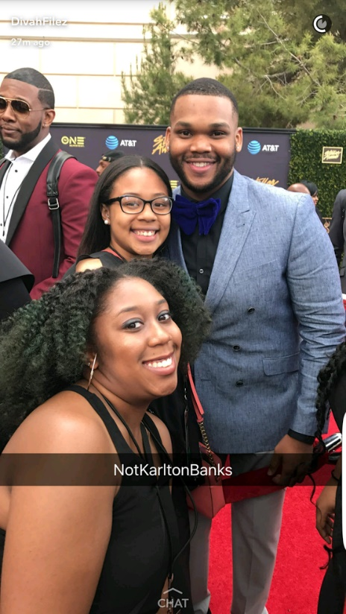
The HBCU and You- Why should you be involved.
HBCU
You
In 2022-2023 The Divah Filez will have 50+ HBCU interns from 19 HBCU institutions.
The total number of students attending the HBCU institutions (projection)- 285,396.
Students will support those who support them in their efforts to succeed.
Students are eager to see successful people who look like them own and operate successful companies.
Many of our interns are heading into their senior years and are preparing and seeking employment.
Exposure to your business in different geographical areas around the country.
Increase in sales and business.
Investing in the future of future entrepreneurs and business owners.
Have the opportunity to expose them to what success looks like outside the four walls of the classroom.
Exposure to future employers.
Dezsane Flowers- Music Hot Trax Editor (Howard University) and GlenAndrea Brown (FAMU)- attending the Stellar Awards in Las Vegas 2017

Slide 6
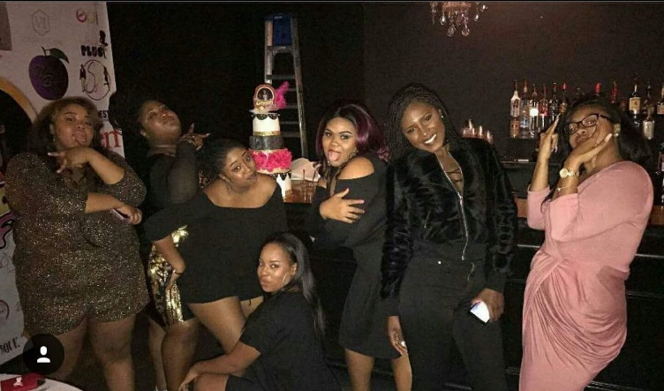
What’s New for 2022-2023
The Divah Interns having fun at the The Divah Filez Black Women’s Business Fair- Atlanta, GA in 2017.
The Divah Filez Radio will expand upon our core sections by adding the following:
Fashion Gawdz will now have a subsection called BeautiFilez which will feature a directory of MUA/Hairstylist around the country. Makeup and Natural Hair Tutorials. It will also feature the hottest beauty trends and product reviews.
HBCU Newz will now have a subsection for EmpowerHER sports, where females HBCU athletes will be featured and Politics to keep students abreast of current activity in politics.
Hot Trax will feature independent artists from HBCU’s and the country. They can sale music directly on the site and grow there fan base direct on the site.
We will officially be recognized as an online magazine. We will still keep our core elements:
The Buzz – Celeb Gossip and Entertainment Newz
Fashion Gawdz- Fashion and Beauty Newz
HBCU Newz- HBCU news, Greek Life and Yard Happenings
Hot Trax- Music News
We will be adding
Sportz Newz
The Divah Filez Mobile Application will be upgraded in June 2018.
A Divah’s Night In HBCU Tour- An empowering night for Freshmen young ladies
IssaHBCUday- HBCU College and Black Business Fair
The Divah’s Take Over the ATL 1/27/2019-All Sorority Greek Step Show.
Chic et Noir 2022

Slide 7
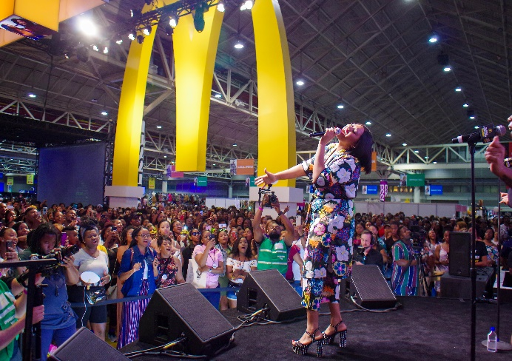
Last Years Numbers and Demographics
What is expected from 2022-2023 school year from the Divah Filez-
79.5% increase in views per month due to the addition of 47 new HBCU interns with populations over 134,488 students.
An online Radio Show
68.2% increase in state demographics due to new HBCU state locations.
52.8% Increase in male views with a new sports and indie music page being incorporated this year.
Our total reach from 2021-2022- 3.1 million
New Saturated Area’s
DMV (DC, Maryland, Virginia)
New Orleans
Texas
Louisiana
Florida
Highest Number of Site Views per week- 282,481
Average Number of Views per Month- 1.7 million
76.2% Female
23.8% Male
68.5% Atlanta
57.1% DMV
42.7% Florida
29.6% North Carolina
17.3% Alabama
11.4% Mississippi

Slide 8
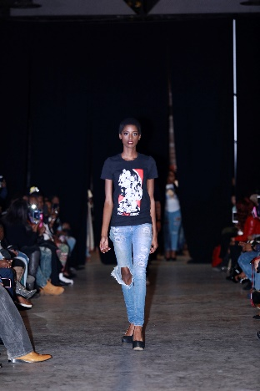
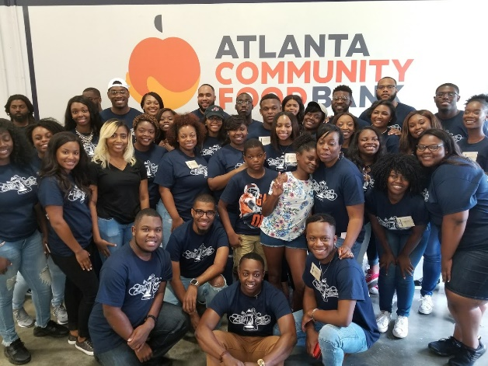
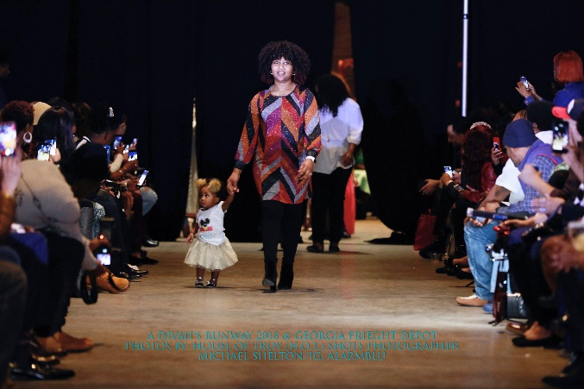
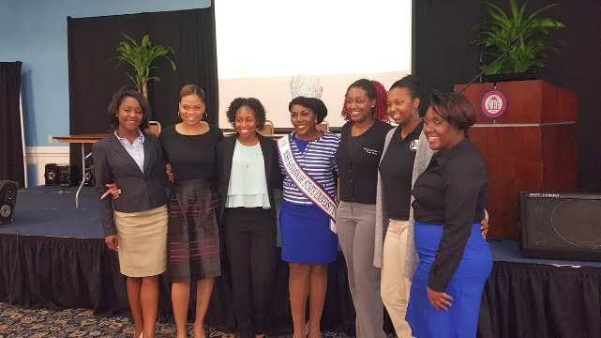
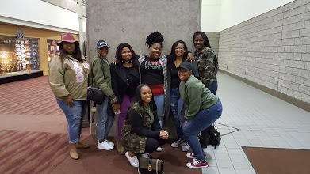
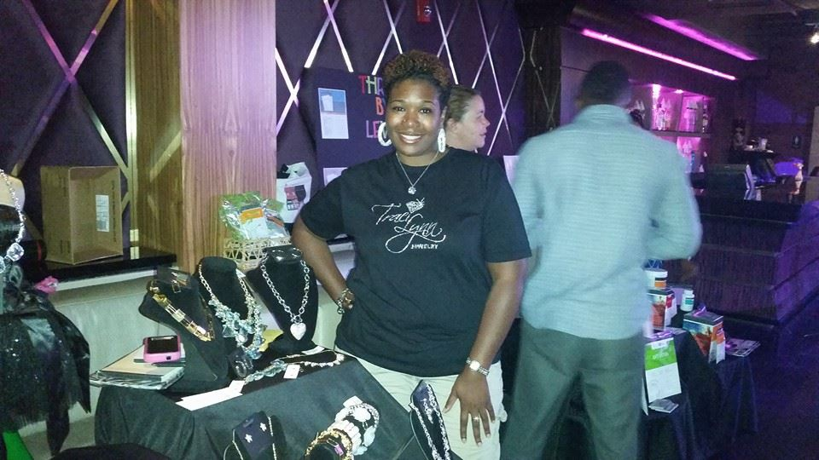
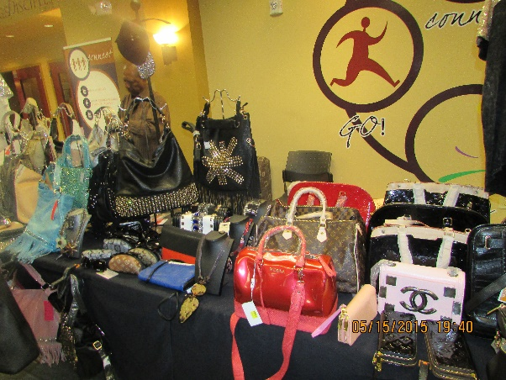
The Divah Filez Past Events
The Divah’s Hair Show- Charlotte, NC
IssaHBCU Day- Atlanta, GA
The Divah Filez Black Women’s Business Fair- Atlanta, GA
Divah’s Take ATL Fashion Show- Atlanta, GA
A Divah’s Runway- Atlanta, GA
Get on FILE with The Divah Filez- NCAT
A Queens Night in- Albany State University
Feed the Hungry- Atlanta Community Food Bank
I’m a Princess Too- FAMU
Wear Your Crown Tour- Morgan State, Central State, Clark Atanta and Grambling State.

Slide 9
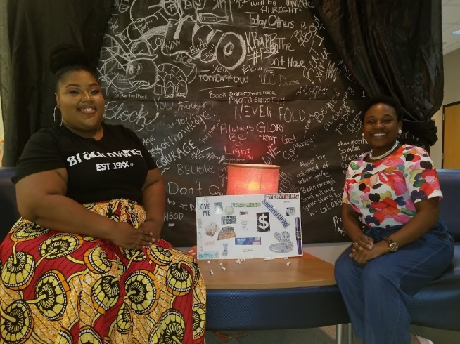
Chic Et Noir Fashion Exp & Pop-Up Shop- This is The Divah Filez Fashion Experience that will take place across the country. 4/19/23 St. Thomas, USVI (The Divah Filez 9th Anniversary) 5/13/23 ATL- Divah Honors- HBCU Heroes Big Hat Brunch and Fashion Show 9/29/23 ATL- BET Hip-Hop Award Weekend (Shades of Melanin Fashion Show) 4/13/24 ATL- Adult Prom Featuring Trina and Amara La Negra
Fashion Designer Packages
Jazmyne Byrd and
Miss Suno 2018-2019
Divah Designer Sponsor $1,500-
Up to 25 Fashion Models (Hair and Makeup Services too)
1-2 celeb models
Customized flyer for the show
Interview opportunities with media outlets (red carpet and online features)
Vending space to sell products
Class Act Designer $1,000-
Up to 15 Fashion Models (Hair and Makeup Services too)
Customized flyer for show
Interview opportunities with media outlets (red carpet and online features)
Vending space to sell products

Slide 10
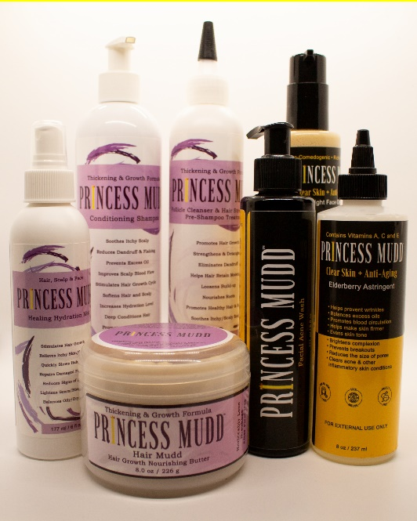
Chic Et Noir Fashion Exp & Pop-Up Shop- This is The Divah Filez Fashion Experience that will take place across the country. 4/19/23 St. Thomas, USVI (The Divah Filez 9th Anniversary) 5/13/23 ATL- Divah Honors- HBCU Heroes Big Hat Brunch and Fashion Show 9/29/23 ATL- BET Hip-Hop Award Weekend (Shades of Melanin Fashion Show)
Sponsorship and Vending Packages
Divah Sponsors- $1,500 (Title Sponsor) – 3 months Radio Marketing (30-sec commercial that will air on Rundown w/the Divahs), Vendor table in VIP and general area, celeb product /service endorsement, Logo on Flyers, Press release, Social media blasts, and Swag Bags.
Classy Sponsors- $1,000 1 month Radio Marketing (30-sec commercial that will air on Rundown w/ The Divahs), Vendor table in General area only Logo on Flyers, Press release, Social media blasts, and Swag Bags)
Poise Sponsors - $500.00 -Vendor table in General area only, Logo on Step and Repeat wall, Logo Flyers, Press release, Social media blasts, and Swag Bags)
Show me Swag Bag Sponsor- $1,000 Logo on Back drop, Flyer, Social Media Blasts and Swag Bag inserts
Vendors
$250- includes table and 2 chairs
Show Performances (NON- HBCU Students)
$500 (1 track) and $1,000 (2 tracks)
Swag Bags- Business cards and/items
$500 (500 items)
$800 (1,500 items)
Payment method- Payment method- Paypal, Cash App, Facebook etc

Slide 11
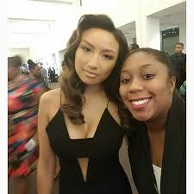
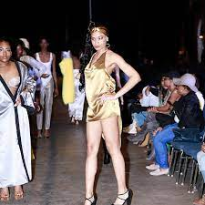
Divah Prom 2024 The Divah Filez will be celebrating 10 years of excellence with a Lavish Prom for the College Class of 2024 who did not get a Prom during their Senior year of High School due to Covid 19. The event will be held on April 13, 2024 in Atlanta GA. We will also be hosting a pop-up shop on December 2, 2023 and February 24,2024, for the beauty industry and designers. We are no strangers to large events and we are ready to celebrate in a major way. We will have several celebs showing up for Prom so be ready to come and show out. Due to COVID-19 a lot of HBCU students struggled to return to school due to finances and living situations. Our goal is to raise $100,000 for HBCU Scholarships. Join us by being a sponsor, vendor or Swag Bag rep. Proceeds from the event will be going towards HBCU students in financial need. Everything is first come first serve. All sponsorship spots require 20% down reserves upfront.
Divah Sponsor $2,500.00
2 VIP Tickets for the Divah Prom
Provide Celebs with Brand Gifting Basket
VIP Seating with Food and Drinks
Swag Bags Placement
Company logo placement on Marketing Materials, Step and Repeat wall, and Swag bags
Interview opportunities with media outlets (red carpet and online features)
Pre-Prom Pop-Up Shop 12/2 or 2/24
Vending space to sell products
Event Wrap Video
Swag Bag product placement
4 Billboards in Atlanta (January- April)
Classy Sponsor (Prom Only)
$1,500.00
2 VIP Tickets for the Divah Prom
Provide Celebs with Brand Gifting Basket
VIP Seating with Food and Drinks
Swag Bags Placement
Company logo placement on Marketing Materials, Step and Repeat wall, and Swag bags
Interview opportunities with media outlets (red carpet only)
Vending space to sell products
Event Wrap Video
Swag Bag product placement
2 Billboards in Atlanta (March- April)

Slide 12
Divah Prom 2024 The Divah Filez will celebrate 10 years of excellence with a Lavish Prom for the College Class of 2024 who did not get a Prom during their Senior year of High School due to Covid 19. The event will be held on April 13, 2024 in Atlanta GA. We will also be hosting a pop-up shop on December 2, 2023 and February 24,2024, , for the beauty industry and designers. We are no strangers to large events and we are ready to celebrate in a major way. We will have several celebs showing up for Prom so be ready to come and show out. Due to COVID-19 a lot of HBCU students struggled to return to school due to finances and living situations. Our goal is to raise $100,000 for HBCU Scholarships. Join us by being a sponsor, vendor or Swag Bag rep. Proceeds from the event will be going towards HBCU students in financial need. Everything is first come first serve.
Divah Vendor Pop-Up Shop- $200.00 (12/2/23)
table
2 chairs
Divah Vendor Pop-Up Shop Ad Book- $200.00 (12/2/23)
Full Page $150.00
Half Page $100.00
Vertical 3rd $75.00
Quarter $50.00
Business card $25
Divah Vendor Prom- $500.00 (4/13/23)
table
2 chairs
Swag Bags- Business cards and/or items
$500 (500 items)
$800 (1,500 items)
Payment method- Payment method- Paypal, Cash App, Facebook etc

